Slide 1
Fake Social Media Profile Detection
Project Guide Prof .R.Sasikala ,M.E , Ph.D AP/CSE(CY)
Project Member
RAM PRAKASH K(717822Y141)

Slide 2
AGENDA
S.NO | Contents
1 | ABSTRACT
2 | INTRODUCTION
3 | OUR PROJECT OVERVIEW
4 | PROBLEM STATEMNT
5 | EXISTING SYSTEM
6 | DRAWBACKS OF EXISTING SYSTEM
7 | PROPOSED SYSTEM
8 | ADVANTAGES
9 | DISADVANTAGES
10 | TOOLS & LANGUAGE USED
11 | HARDWARE SPECIFICATION

Slide 3
S.No | Contents
12 | USE CASES
13 | IMPLEMENTATION
14 | WORK FLOW
15 | DATA SET DESCRIPTION
16 | MAIN MODEL
17 | OUTPUT GRAPHS
18 | MODEL RESULTS
19 | CONCLUSION

Slide 4
ABSTRACT
With the rapid expansion of social media platforms, the proliferation of fake profiles has become a significant concern. These fake profiles can propagate misinformation, manipulate public opinion, and engage in fraudulent activities. Detecting such profiles manually is time-consuming and often ineffective due to the sheer volume of users. Therefore, automated methods utilizing deep learning techniques have emerged as crucial tools in addressing this issue.

Slide 5
INTRODUCTION
This project proposes the development of a deep learning model-based system for detecting fake social media profiles, prioritizing accuracy, efficiency, and transparency. By leveraging the power of machine learning algorithms to analyze user behavior, profile characteristics, and other relevant factors, this system aims to provide a robust and reliable means of identifying and mitigating the risks associated with fake profiles, ultimately enhancing the overall security and authenticity of online social interactions.

Slide 6
OUR PROJECT OVERVIEW
Our project overview is to train an deep learning model using the dataset of fake and genuine profiles of the social media.

Slide 7
PROBLEM STATEMNT
Fake social media profiles pose significant challenges and concerns in the realm of social media security and user privacy. While some fake profiles may be created for harmless reasons, such as pranks or parody accounts, they are often associated with malicious intent, such as spreading misinformation, cyberbullying, identity theft, and fraud.

Slide 8
EXISTING SYSTEM
Botometer (formerly BotOrNot), a popular system developed by researchers at Indiana University and the University of Southern California specifically for detecting Twitter bots. Botometer analyzes various attributes of Twitter accounts, including activity patterns, friend networks, and linguistic features, to determine the likelihood of an account

Slide 9
DRAWBACKS OF EXISTING SYSTEM
Limited to Twitter: Botometer is specifically designed for detecting bots on Twitter, and it may not be effective for detecting bots on other social media platforms.
Limited to public data: Botometer only analyzes publicly available data, which means that it may not be able to detect bots that operate in private or closed networks.

Slide 10
PROPOSED SYSTEM
Detecting fake profiles in social media using deep learning involves training a model to analyze various aspects of user profiles and behaviors to identify patterns associated with fakeness.
Idea focuses on the development of a detection model employing deep learning techniques to effectively differentiate between Genuine and Fake profiles.
Use of various Deep learning Models to detect multiple types of fake social media profiles and create a data-graph report.

Slide 11
ADVANTAGES
Social media Platform independent
More accuracy

Slide 12
DISADVANTAGES
Limited Functionality
Manual Retrieval of Data
Access Required of collecting data

Slide 13
TOOLS & LANGUAGE USED
Language : Python
Tool : Google Colab

Slide 14
HARDWARE SPECIFICATION
Intel Core i5 or equivalent
NVIDIA GeForce GTX 1050 or equivalent
RAM Minimum: 8GB

Slide 15
Use cases
Misinformation and Fake News Detection
Phishing and Scam Detection
Fake Review and Rating Detection
Political Manipulation and Influence Campaign Detection
User Verification and Trust Building

Slide 16
IMPLEMENTATION
Importing the needed library
Loading the test and train dataset
Data pre processing
Various data exploration and visualization tasks on the training and testing datasets
Main model
Model evaluation

Slide 17
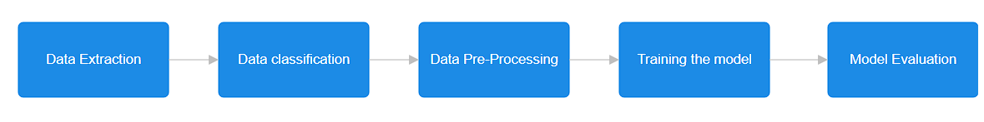
WORK FLOW

Slide 18
Data set description
Profile Pic (Binary): Indicates whether the user has a profile picture (0 for no, 1 for yes)
Username (Text): Username of the user
Username Length (Numeric): Length of the username
Full Name Words (Numeric): Number of words in the full name
Full Name (Text): Full name of the user
Full Name Length (Numeric): Length of the full name
Name Equals Username (Binary): Indicates whether the full name is the same as the username (0 for no, 1 for yes)
Description Length (Numeric): Length of the user's profile description
External URL (Binary): Indicates whether the user has an external URL in their profile (0 for no, 1 for yes)
Private (Binary): Indicates whether the user's account is private (0 for no, 1 for yes)
Number of Posts (Numeric): Number of posts made by the user
Number of Followers (Numeric): Number of followers the user has
Number of Follows (Numeric): Number of accounts the user follows
Fake (Binary): Indicates whether the user account is fake (0 for no, 1 for yes)

Slide 19
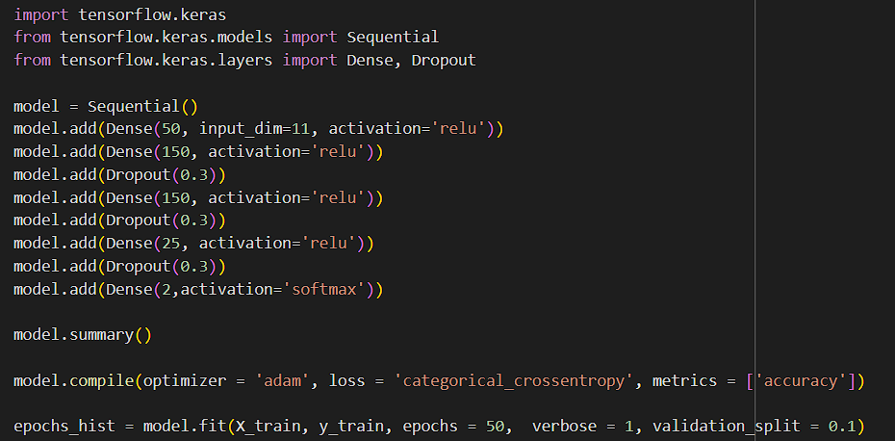
MAIN MODEL

Slide 20
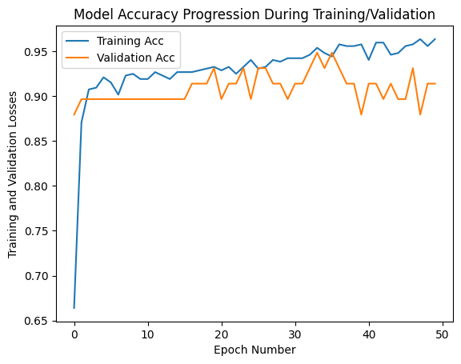
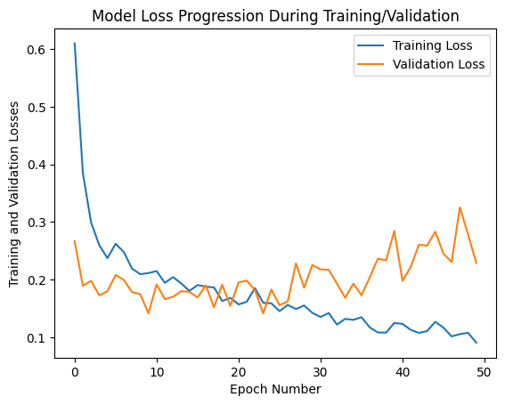
OUTPUT GRAPHS

Slide 21

MODEL RESULTS

Slide 22
CONCLUSION
Detecting fake social media profiles is important for keeping online spaces safe. Fake accounts can spread false information and commit fraud. Social media platforms can use advanced technology to spot unusual behavior and verify user identities. Regular updates and checks help stay ahead of new tricks. By using these methods, platforms can find and remove fake profiles, making the internet safer for everyone.

Slide 23
THANK YOU

